Slide 1
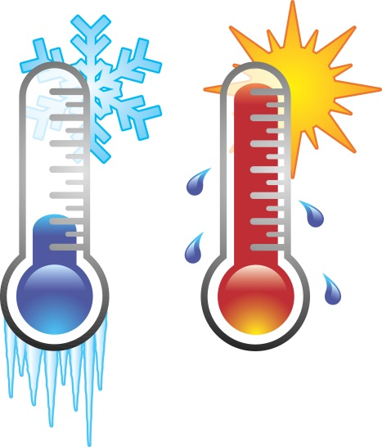
ISA EXAMS
12 October 2012
Objectives: Understand that you will have 2 practical exams as part of your Science Practical Controlled Assessment (Individual Skills Assessment) and these will be added up to be worth 25% of your GCSE in science. Complete all the stages of the ISA (7 lessons + 1 homework) to the very best of your ability – there is no foundation tier or higher tier in the ISA, you can get an A* if you work hard

Slide 2
Science ISA
Stage 1 – Planning – limited control
Introduction to investigation
* Students must research the context of the investigation and identify a method that could be used including a risk assessment
* Candidates must create one side of handwritten A4 of their own research that will be used in steps 2 & 5, written on the Candidate Research notes AQA sheet – this is a structured writing frame
Stage 2 – Reporting on the planning research – high control
* Produce a blank results table – this may be completed during or immediately after the Section 1 exam, but under controlled conditions
* Section 1 of ISA exam – exam conditions 45 minutes = 20 marks. This tests students on hypothesise, sources used, variables, testing hypothesise, preliminary investigations, writing detailed methods, risk assessing and producing a results table.
* students can take in their Candidate Research notes sheet.

Slide 3
Science ISA
Stage 3 Practical work – limited control Undertake practical work either individually or in groups Use school/AQA method and provide students with a results table to use
Stage 4 – Processing Primary Data – high control Draw graph or bar chart of own results – must work individually under direct supervision
Stage 5 – analysing results – high control
Section 2 of ISA exam – exam conditions 50 minutes = 30 marks. This tests students on conclusions and evaluation: how to analyse results and draw conclusions; how to match results to a hypothesis; how to evaluate method of collecting data and quality of results; how to analyse secondary data
* students can take in their Candidate Research notes sheet

Slide 4
Keywords – to be learnt!

Slide 6
ISA – the next 7 lessons
Homework from today’s lesson – Research sheet to be completed for next lesson
Stage 1 = 2 lessons ISA RESEARCH (surface area and cooling) limited control | HW sheets, science A text books, CRN – Candidate Research Notes
Stage 2 ISA SECTION 1 EXAM Planning high control | Section 1 exam, black pens, 30cm rulers, sharp pencils, completed CRN
Stage 3 ISA PRACTICAL Surface Area and Cooling limited control | Follow a method and complete a practical to get valid, reliable results
Stage 4 ISA Drawing Graph high control | Graph paper, black pens, 30cm rulers, sharp pencils
Stage 5 ISA SECTION 2 EXAM Analysis and Evaluation high control | Section 2 test, black pens, 30cm rulers, sharp pencils

Slide 7
ISA
Testing the Hypothesis:
The rate at which a container of water cools depends upon the surface area of the water exposed to the open air.

Slide 8
The homework is REALLY important.
Everything from today’s lesson and that you do in your homework gets written on your CRN (cheat sheet) next lesson and you are allowed to take it into your exam. All the questions on the homework sheet are in the first exam.
HOMEWORK IS DUE NEXT LESSON

Slide 9
Q1. Background Research.
Name two sources that you used for your research. This can be a:
Textbook (mention the publisher)
The internet. You need the full web address such as….
http://www.bbc.co.uk/bitesize/standard/physics/energy_matters/heat_in_the_home/revision/1/

Slide 10
Q1. Background Research
You must explain which one of your sources of information is the most useful.
You must comment on both, such as…
eg Source 1 gave me a complete method of what to do. Source 2 gave me information about how convection works in fluids and what affects rate of heat loss

Slide 11
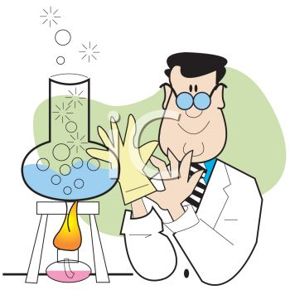
Q2. Control Variable and Preliminary Test.
This is where you plan what you would do and how it would help you produce a real method.
In this question mention the how the results you gather would help you eg…..
I would change the surface area of each beaker and measure the temperature of the water to see if it made a measurable difference to the temperature change after 5 minutes, if not I would adjust the starting temperature of the water or the amount of time I left it.

Slide 12
Q3. The Plan.
Equipment with volumes, sizes and amounts
Mention two variables that must be kept the same in order to make the investigation a fair test.
Mention the independent variable and how this will be varied and the dependent variable.
Risk assessment, what are the risks and how can they be controlled.
You may bullet point your method as long as it is well structured in a logical sequence. Check your spelling, punctuation and grammar and use technical/scientific terms

Slide 13
Q4. Comparing Results.
Explain the advantage of sharing results with others?
Reproducibility – measurement repeated by another person, or by using different equipment or techniques and the same results are obtained.
Eg If all the class results are shared then we can
calculate a mean and that would give us a more
accurate result. If the results are reproducible I must have carried out the test correctly. This will only work if the starting temperature is the same for all methods.

Slide 14
Key Questions.
What was the independent variable?
What was the dependent variable?
What safety precaution must you make?
Name two variables that you must control.
How would repeating my experiment affect my results?
How would comparing my results with some else improve my results?

Slide 15
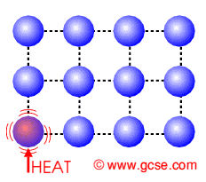
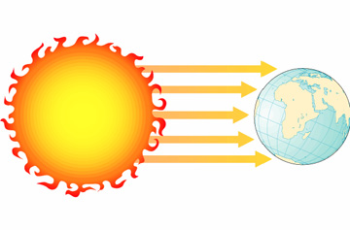
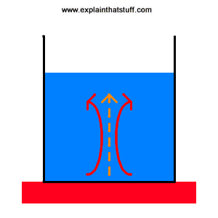
Here comes the science bit…
There are 4 main ways that objects lose heat:
Conduction
Radiation
Convection
Evaporation
Conduction is the loss of heat through the collisions of particles
Radiation is the transfer of energy by waves
Convection is the loss of heat by the flow of particles as they get less dense and rise (or get more dense an fall)
Evaporation is the loss of heat as the attraction between particles breaks as they are given more energy. These particles with this energy is then lost from the liquid.

Slide 16
In our experiment what are the two main ways that heat will be lost?
Evaporation
Convection

Slide 17
What is evaporation?
Evaporation occurs when the particles in a liquid escape to form a vapour.
Evaporation can occur at any temperature but it occurs most rapidly at a liquid’s boiling point.
The particles that escape take some energy from the remaining particles and so the temperature of the liquid falls.
Evaporation is another method of heat transfer.

Slide 18
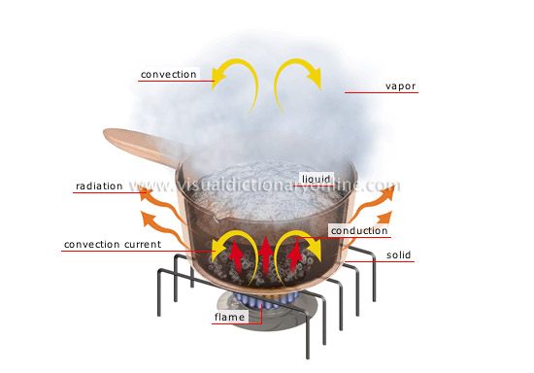
Convection
Convection occurs when fluids are heated up.
As particles are given more energy they move around more and spread out. (become less dense)
These particles then rise and the liquid loses heat energy.

Slide 19
Demo
Your teacher will now demo the practical you will do.

Slide 20
Definitions Quiz
ISA Preparation

Slide 21
Q1. Accuracy is………
A = A precise measurement
B = An measurement close to the true value
C = A measurement of a variable

Slide 22
Q2. If investigating which species of tree which gives the most shade, the species of tree would be….
A = A categoric variable
B = A control variable
C = A continuous variable

Slide 23
Q3. Which of the following would make an experiment reliable?
A = Repeated results that are similar or the same. More repeats allows anomalies to be identified.
B = Valid data to make the test fair.
What is the other definition describing?
Validity

Slide 24
Q4. The mean of a set of results is found by….
A = Adding up all the data and dividing by the number of data values.
B = Finding the smallest and largest values.
What is the other definition describing?
Range

Slide 25
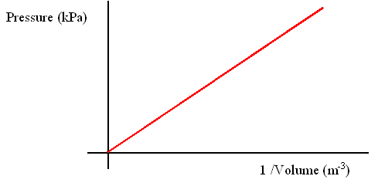
Q5. What type of relationship does this graph show?
A = A positive correlation
B = A negative correlation
What else could we say about the relationship?
Directly proportional

Slide 26
Q6. The variable you change in an experiment is the….
A = Control variable
B = Dependent variable
C = Independent variable
D = Discrete Variable

Slide 27
Q7. The variable you keep the same in an experiment is the….
A = Control variable
B = Dependent variable
C = Independent variable
D = Discrete Variable

Slide 28
Q8. The variable you measure in an experiment is the….
A = Control variable
B = Dependent variable
C = Independent variable
D = Discrete Variable

